Slide 1
Supporting families early:
Longitudinal evidence on public housing
and child wellbeing
Jaimie Monk, Arthur Grimes
Motu Research
AIFS Conference
9 September 2026
This work was supported by the MBIE Endeavour Programme, Public housing and urban regeneration: maximising wellbeing (Grant ID:20476 UOOX2003)
Notes:
Me
From NZ
Wider programme
NZ housing situation
New Zealand households spend more of their disposable income on housing costs than nearly any other country in the OECD, despite having relatively poor-quality housing stock.
4% public housing vs 7% OECD.

Slide 2

Contents
Introduction
Method
Growth curve results
Placebo analysis results
Conclusions and policy implications
Source: Getty images

Slide 3
What were we interested in?
What are the wellbeing trajectories for New Zealand children who receive public housing during the crucial early years?
How do these trajectories differ from children who start life in other tenure types?
Are the findings similar for tamariki Māori?
Introduction
Method
Growth curves
Placebo analysis
Conclusions
Notes:
Talk about 12 year results as well.
Talk about Māori strand and whakawhanaungatanga

Slide 4
Figure 1: Pathways housing is theorised to affect child wellbeing
Security of tenure
Parent wellbeing
Child subjective wellbeing
House affordability
Financial security
Child physical health
House quality & size
Notes:
Explain difference between family stress and investment approach

Slide 5
Method

Slide 6

Growing up in New Zealand
A contemporary child-focused longitudinal study following 6,852 children starting in 2009/10.
Diverse and broadly generalisable to the New Zealand population in terms of ethnicity and socio-demographic variables.
Our research focuses on mother and child data (mother-reported) from the pregnancy to 8-year-old waves.
Introduction
Method
Growth curves
Placebo analysis
Conclusions
Notes:
Mention why not fathers and 12 year results.

Slide 7
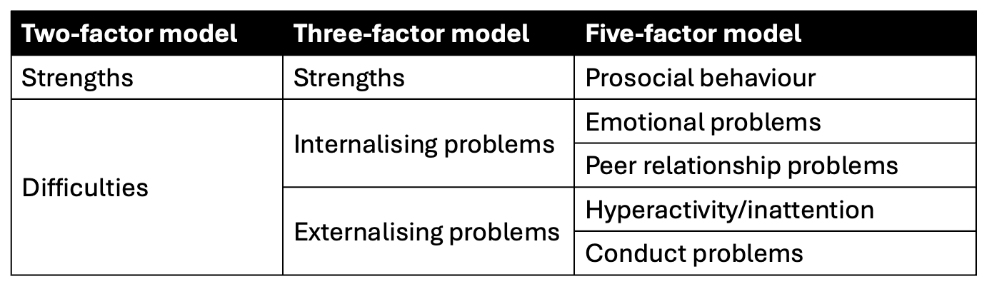
Outcome variables - Child behaviour
Developed from the Strengths and Difficulties Questionnaire (SDQ)
Introduction
Method
Growth curves
Placebo analysis
Conclusions

Slide 8
Key independent variable - Initial housing tenure
Four categories based on a mother’s response to legal ownership of her home:
Private ownership (outright, or with a mortgage) (52.3%)
Public rental (9.1%)
Private rental (35.8%)
Other (2.9%)
Introduction
Method
Growth curves
Placebo analysis
Conclusions
Notes:
. – Chosen as focus on first 2000 days.

Slide 9
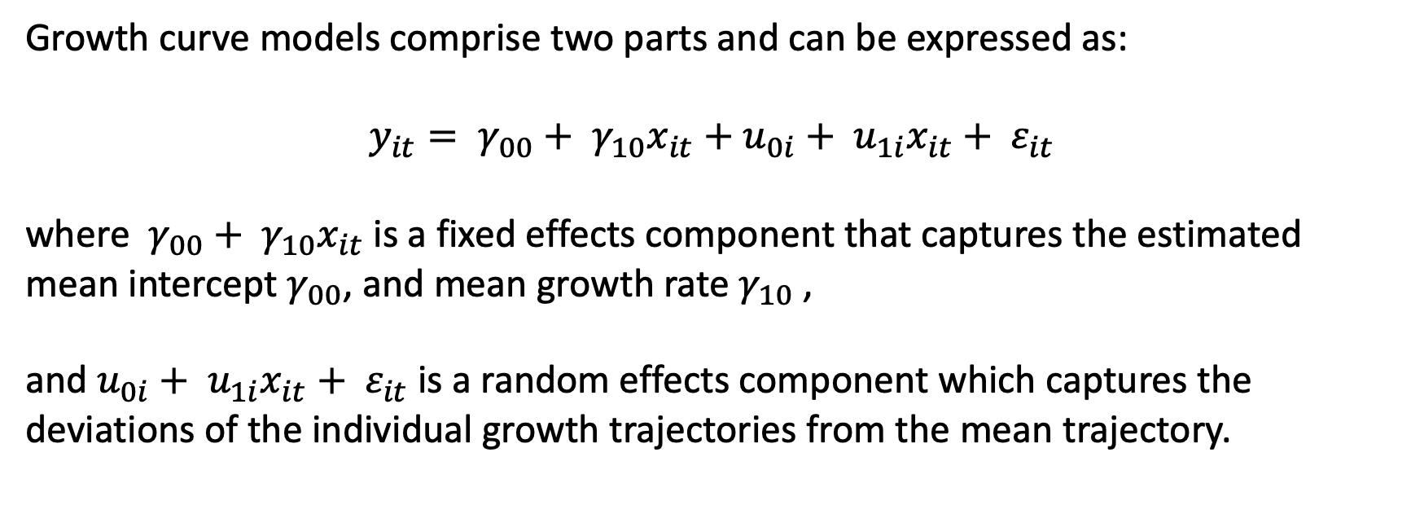
Growth curve analysis
Growth curve models comprise two parts and can be expressed as:
$$y_{it}= γ_{00}+ γ_{10}x_{it}+u_{0i}+ u_{1i}x_{it}+ ε_{it}$$
where $γ_{00}+ γ_{10}x_{it}$ is a fixed effects component that captures the estimated mean intercept $γ_{00}$, and mean growth rate $γ_{10}$,
and $u_{0i}+ u_{1i}x_{it}+ ε_{it}$ is a random effects component which captures the deviations of the individual growth trajectories from the mean trajectory.
Introduction
Method
Growth curves
Placebo analysis
Conclusions

Slide 10
Growth curve analysis
Model 1 | Age +age²
Model 2 | Model 1 + tenure + tenure (age + age² )
Model 3 | Model 2 + sex + sex (age + age² ) + household structure + household structure (age + age² )
Model 4 | Model 3 + maternal education + maternal age + maternal ethnicity + household material deprivation + neighbourhood deprivation
Introduction
Method
Growth curves
Placebo analysis
Conclusions
Notes:
Series of models with extra controls.
Quadratic
Centered on 2 years
Plotted each individual month.
An unstructured covariance matrix is specified for the random effects.

Slide 11
Growth curve results
2 years – 9 years

Slide 12
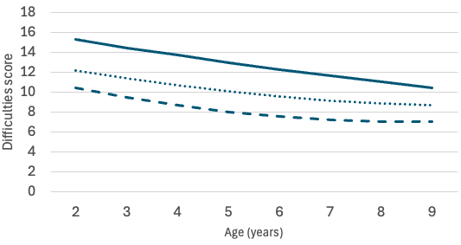
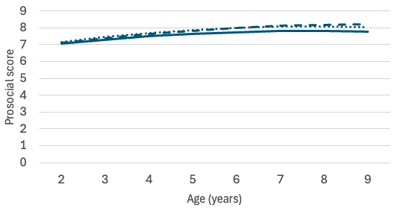
Figure 2: Trajectories of socio-emotional development by initial housing tenure
Difficulties
Strengths
Source: Growing Up in New Zealand, DCW0, DCW1, DCW2, DCW5, DCW8
Notes:
Data captured at 2, 4.5 and 8 years
Mention the fact likely to be higher convergence, if only use balanced model. Unable to use MI due to models crashing.

Slide 13
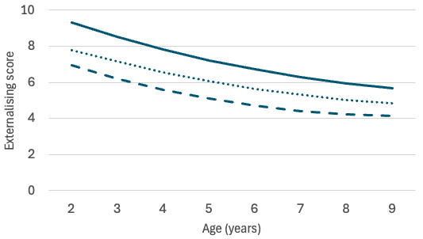
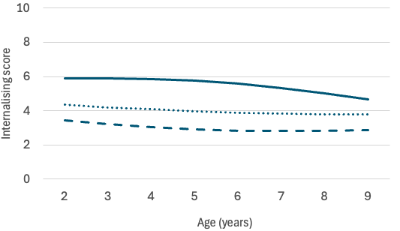
Figure 3: Trajectories of socio-emotional development by initial housing tenure
Externalising
Internalising
Source: Growing Up in New Zealand, DCW0, DCW1, DCW2, DCW5, DCW8

Slide 14
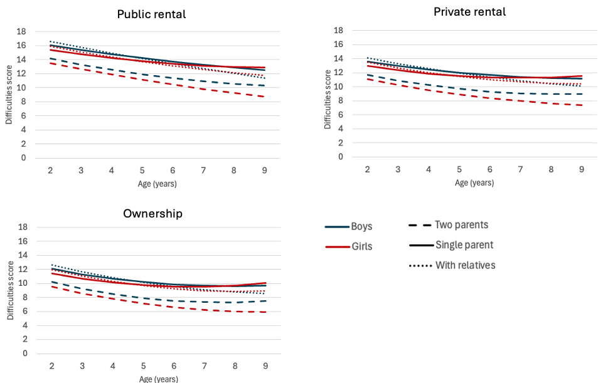
Figure 4: Trajectories of difficulties scores by tenure, gender and household structure
Source: Growing Up in New Zealand, DCW0, DCW1, DCW2, DCW5, DCW8
Notes:
Emphasize difficulties outcomes
Talk about difference between relatives and single parents

Slide 15
Placebo analysis

Slide 16
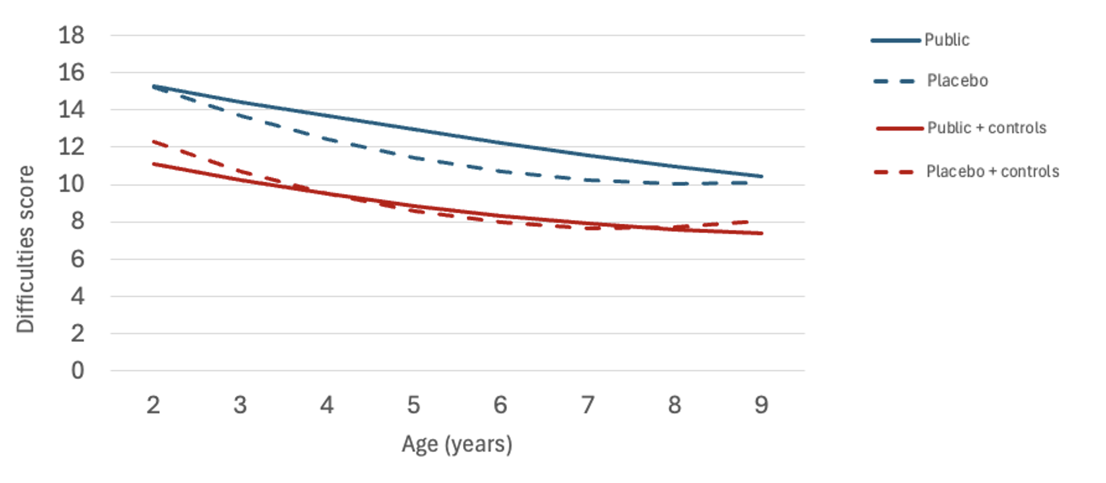
Placebo analysis
Introduction
Method
Growth curves
Quality of life
Conclusions
Notes:
Public housing better.
Model 4 – controls for sex, household structure, maternal education, maternal age ethnicity, material deprivation and neighbourhood deprivation.

Slide 17
Conclusions
Conclusions
Policy implications

Slide 18

Conclusions
Wellbeing disparities are greatest in the early years, but start to converge over time.
Child strengths/prosocial behaviour does not vary by tenure.
Household structure is an important part of the picture when assessing housing and child wellbeing.
Introduction
Income & behaviour
Technology
Stress & housing
Conclusions

Slide 19

Policy implications
We need to consider children’s housing needs with a developmental perspective. Early years support is important.
While child behaviour outcomes converge over time, disparities exist when children start school and these may set children on poor educational pathways.
Source: Getty images
Introduction
Income & behaviour
Technology
Stress & housing
Conclusions

Slide 20


Questions?
jaimie.monk@motu.org.nz
Full report link
Source: Getty images

